Slide 1
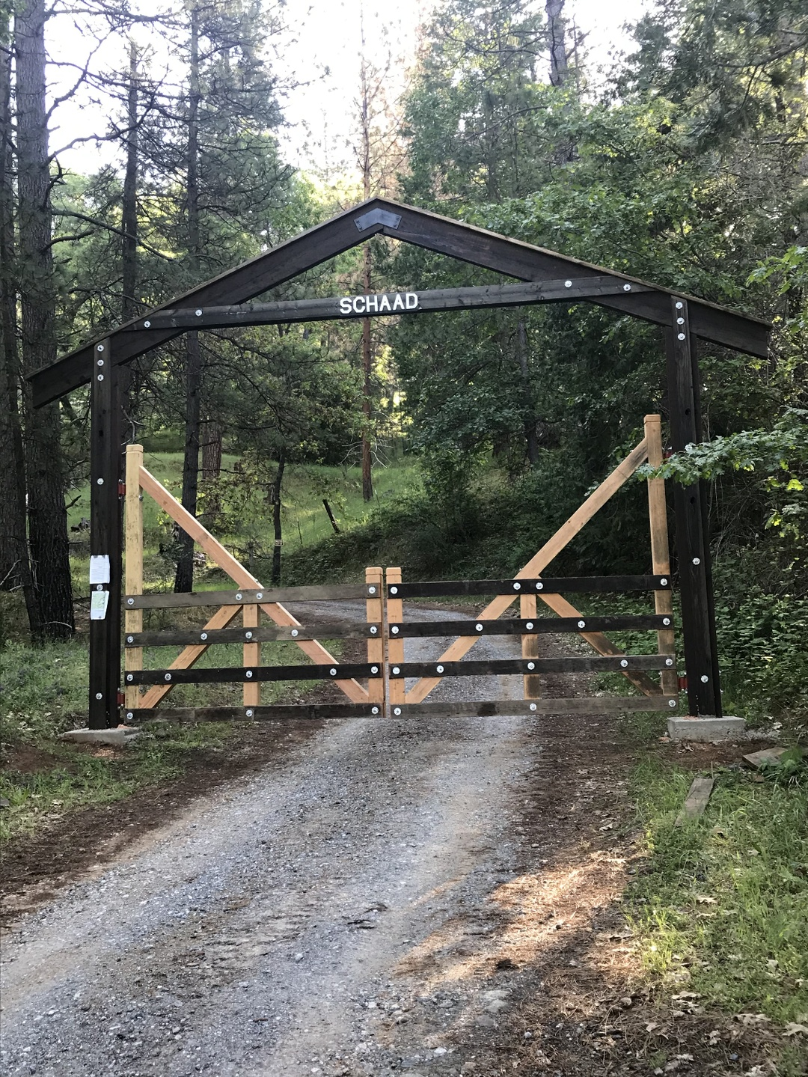
NORTHERN CALIFORNIA
✦ OPPORTUNITY ZONE
Gateway to a Unique Investment Opportunity.
Timber &
Conservation
Portfolio
468
7M bf
$4.4M+
$3.4M
Total Acres
Timber
Asset Value
Asking Price
Schaad Family Stewardship Since 1873 · Wilseyville, California · 3,000 ft Elevation
Confidential Investment Offering · NDA & Data Room Available Upon Request

Slide 2
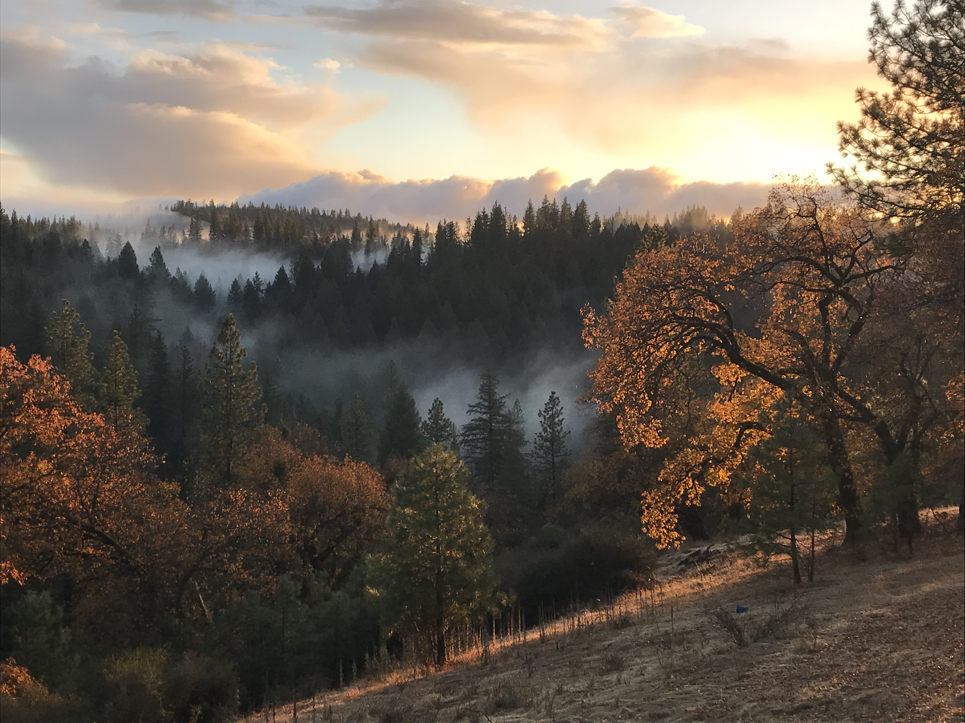
The Next Steward
For more than 150 years, this land has been cared for — not simply owned.
Its forests have been managed with intention.
Its rivers have been protected.
Its wildlife has flourished.
Four generations have left it healthier than they found it.
Today, we are not simply offering a remarkable property.
We are passing the stewardship of an extraordinary place to the
person or family who sees its future as clearly as we have seen its past.

Slide 3






THE OPPORTUNITY
A Rare Convergence of Timber,
Conservation & Tax Advantage
Working Forest
Opportunity Zone
468 contiguous acres — two active NTMPs. Harvest-ready from day one.
Federally designated OZ. Capital gains deferral, reduction, and 10-year elimination.
Carbon Credits
Fire-Hardened
$25K–$90K annually. CFIP history and NTMP documentation are strong eligibility signals.
150 acres improved via CFIP — mastication, thinning, pruning. Documented fire-resistant plan.
River Frontage
Conservation Easement
1 mile of NorCal river frontage. Increasingly rare and valuable in California's water environment.
$500K–$1M+ in potential federal tax deductions for the right buyer.

Slide 4
THE ASSET
Two Parcels. One Controlled Portfolio.
YOUR PARCEL
232 Acres
192 acres timberland + 1 mile of river frontage
~3 Million board feet standing timber
Active NTMP since 2004
150 acres CFIP-improved — mastication, thinning, pruning
Documented fire-resistant management plan
Custom home — GF zoning, ADU permitted
Paved county road + internal sub-roads
ADJACENT PARCEL
236 Acres
~4 Million approved board feet
Species: Ponderosa pine, Douglas fir, incense cedar
Active NTMP in place
Power on property
Paved county road + internal sub-roads
GF zoning — primary home + ADU permitted
Rick holds recorded First Right of Refusal

Slide 5
THE VALUE CASE
Priced at a $964,000+ Discount
to Conservative Asset Value
7M bf Timber @ $350/mbf
$2,450,000
468 Acres Land @ $2,000/ac
$936,000
Custom Home & Improvements
$628,000+
River Frontage Premium
$200,000+
Infrastructure (Roads/Power)
$150,000+
Total Asset Value
$4,364,000+
Asking Price
$3,400,000

Slide 6
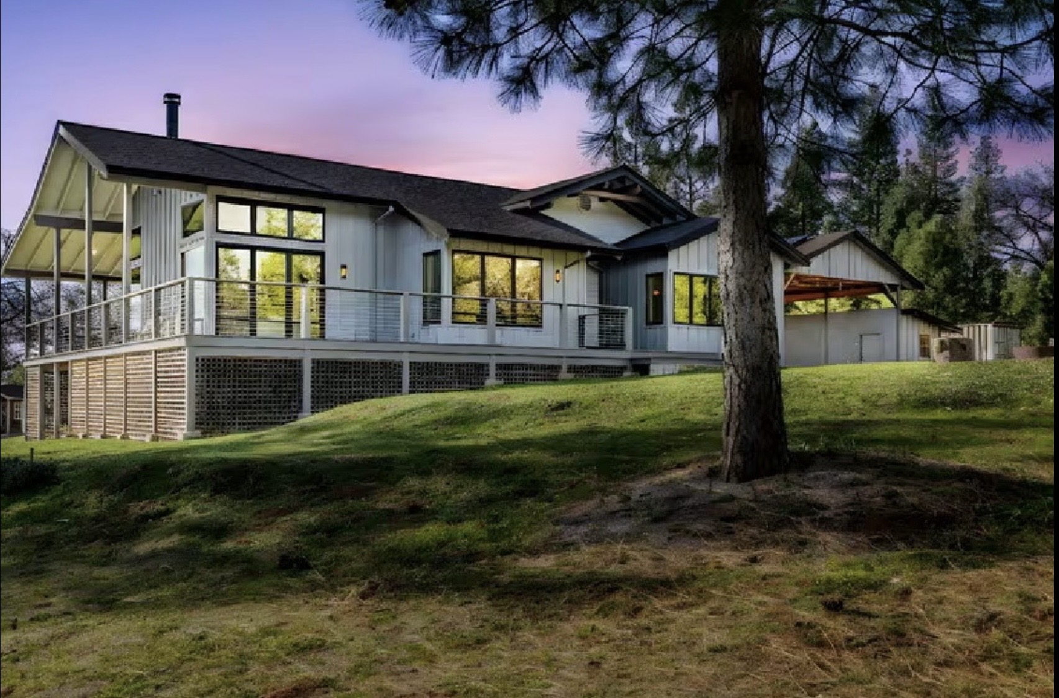
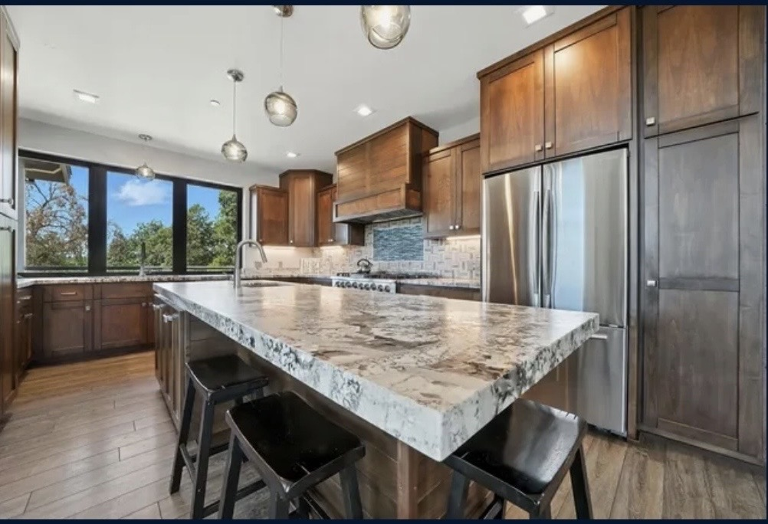
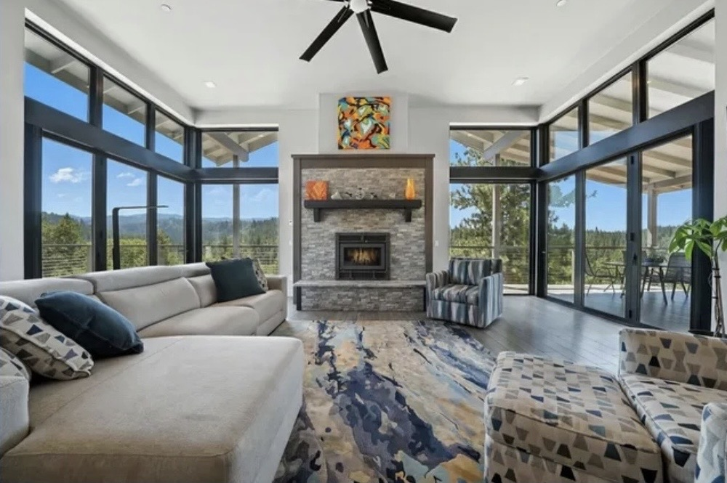




THE RESIDENCE
An Architecturally Designed Home
Built for This Land.
Custom Home Exterior — 3,000 ft Elevation, Sierra Nevada Foothills
Chef's Kitchen
Great Room — Fireplace & Views
1,860 sf
WUI
Off-Grid
Living Area
Fire Compliant
Solar Powered
WUI Compliant Construction
Built to Wildland-Urban Interface fire standards — a critical advantage in today's California insurance environment.
Radiant Floor Heating
Whole-home radiant system — efficient, even warmth with no forced air. Ideal for the 3,000-ft Sierra Nevada elevation.
Solar — Off-Grid Capable
Full solar with battery storage. Operates independently from the grid — self-sufficient and resilient.
ADU Permitted
GF zoning permits an additional dwelling — caretaker, guest accommodation, or rental income.

Slide 7
INCOME & RETURNS
Multiple Independent Return Drivers
Timber Harvest
Long-Term Upside
7M bf of ponderosa pine, Douglas fir & incense cedar. Harvest-ready under two active NTMPs. Specialty cedar markets provide SPI-independent pricing options.
↳ Positioned as appreciation upside, not primary return
Carbon Credits
$25K – $90K / year
Voluntary market: $25K–$45K/yr. California ARB compliance: $60K–$90K/yr. CFIP and NTMP history are strong eligibility signals.
↳ Independent of timber pricing — concurrent income
Conservation Easement
$500K – $1M+ Deduction
River frontage + managed forest are ideal easement candidates. Federal deduction can be structured in year of acquisition.
↳ One-time federal tax benefit — significant for right buyer
Opportunity Zone
10-Year Tax Elimination
Defer and reduce capital gains on invested proceeds. All appreciation within the OZ investment is tax-free after a 10-year hold.
↳ Compelling for recent liquidity event holders

Slide 8
THE TAX STACK
Few Properties Offer
This Combination
Opportunity Zone
Up to $1M+
1
Capital gains deferral + 10-year elimination
Conservation Easement
$500K – $1M+
2
Federal income tax deduction on donated easement value
Section 1231 Timber Gains
Ongoing
3
Harvest income taxed at capital gains rates, not ordinary income
Carbon Credit Income
$25K – $90K/yr
4
Recurring annual revenue independent of harvest or SPI pricing
TPZ / GF Property Tax
Lower carry cost
5
Reduced property tax assessment based on timber income value

Slide 9




INFRASTRUCTURE
Turnkey. No Capital Outlay Required.
Paved County Road
Both parcels served by paved county road — no private road maintenance liability for the buyer.
Internal Sub-Roads
Numerous sub-roads across both parcels provide immediate equipment access for timber harvest.
Power On Property
Electrical service on Karl's parcel. No costly power extension required.
Custom Home
Fully improved custom residence on the primary parcel. ADU permitted both parcels under GF zoning.
River Frontage
1 mile of NorCal river frontage — rare and increasingly valuable in California's water environment.
Harvest Ready
Both NTMPs active. A buyer can initiate harvest planning immediately upon closing.

Slide 10
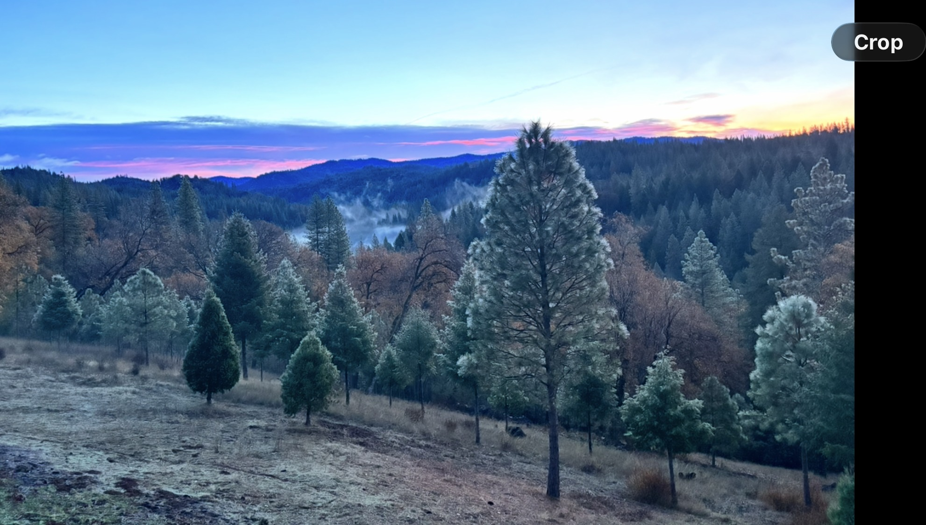
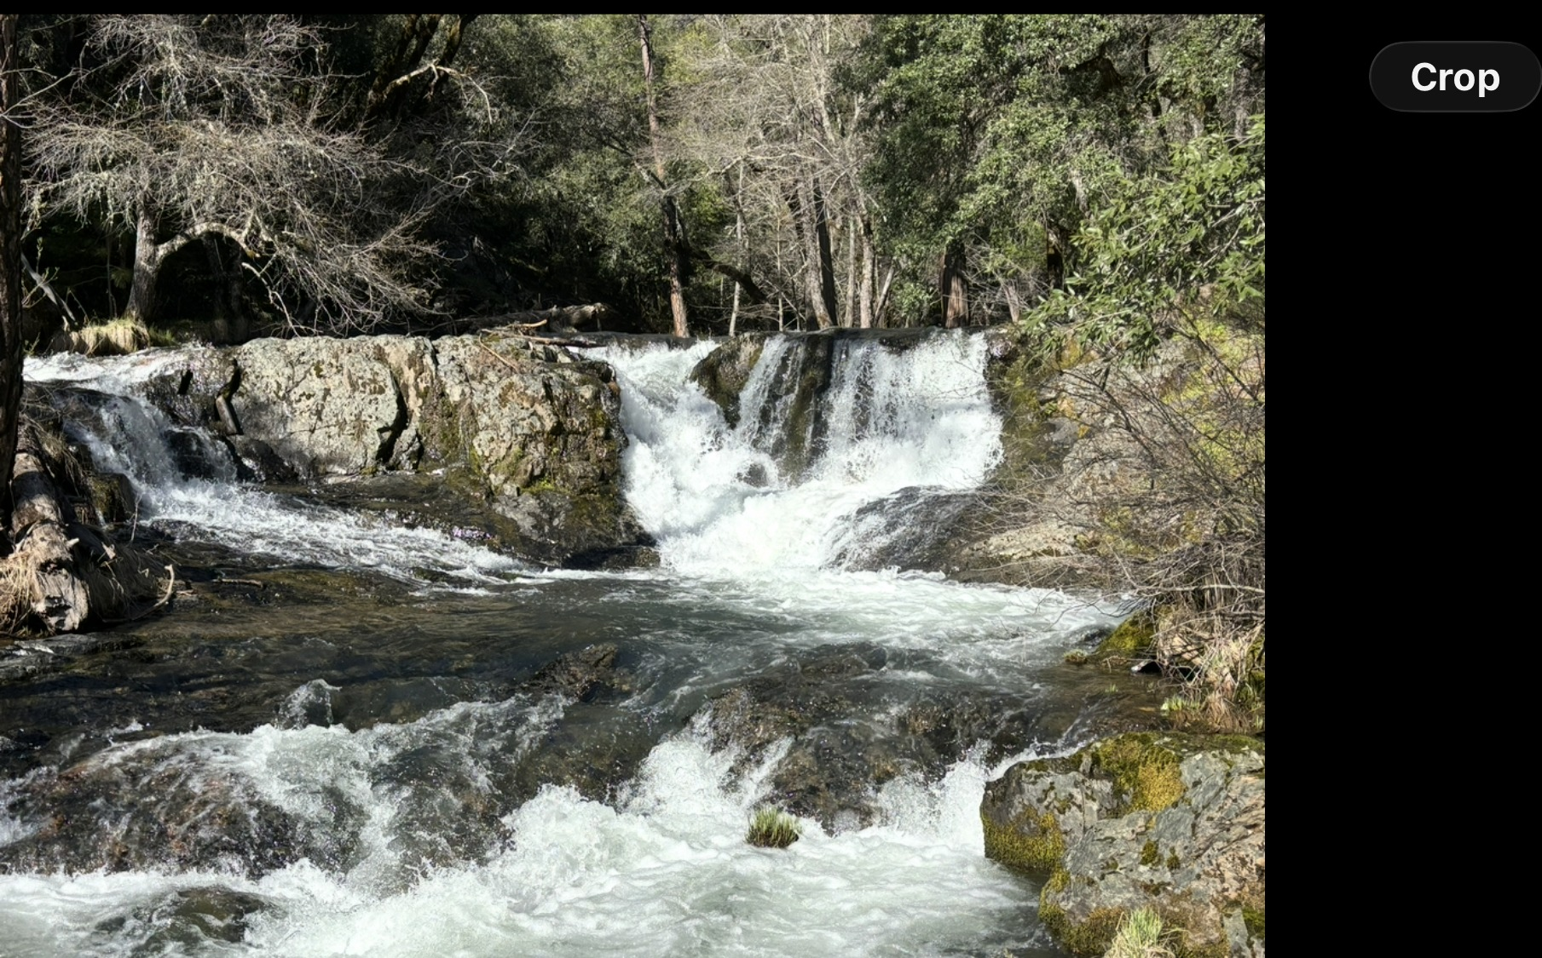
THE LAND
468 Acres of Managed Forest,
River & Open Sky.
Sunrise over the Mokelumne River valley — managed ponderosa pine, Douglas fir & incense cedar
Forest Creek — 1 mile of year-round river frontage on the property
Schaad Ranch · Wilseyville, CA · Calaveras County

Slide 11




THE LEGACY
More Than an Investment.
A Living Asset for Generations.
Multigenerational Stewardship
468 acres of managed Northern California forest, river, and timberland. A self-sustaining property that can be passed to the next generation with income in place.
A Forest That Works For You
Active timber management, carbon income, and conservation values create a property that pays its own carrying costs while appreciating as a finite hard asset.
River, Forest & Open Sky
1 mile of river frontage alongside 428 acres of managed forest. A rare combination of productive land and natural beauty increasingly unavailable in California.
A Community of Care
20+ years of active forest management, fire hardening, and habitat improvement. This land has been loved and stewarded — and is ready for its next chapter.

Slide 12
WHO THIS IS FOR
The Right Buyer Sees All of This at Once
TIER 1
OZ Fund / Tax-Motivated Buyer
Recent capital gains event. Seeking to defer, reduce, and eliminate gains. 180-day clock creates urgency.
TIER 1
1031 Exchange Buyer
Deadline-driven. Motivated. Less price-sensitive. Seeking like-kind NorCal land with income potential.
TIER 1
Regional TIMO
Institutional timber buyer. Values active NTMPs, documented volume, and immediate harvest eligibility.
TIER 2
Family Office
Hard asset diversification. Inflation hedge. Multigenerational hold. Self-financing via carbon and timber.
TIER 2
Conservation Easement Buyer
Land trust or conservation finance buyer. River frontage + managed forest are ideal easement candidates.
TIER 2
International Legacy Buyer
European or Asian family office seeking U.S. hard assets with natural resource and conservation value.

Slide 13
ANNUAL INCOME POTENTIAL
This Property Can Pay
For Itself — From Day One
Carbon Credits — Voluntary Market
Eligible now. CFIP history and NTMP documentation are strong qualification signals.
$25,000 — $45,000 / yr
Carbon Credits — CA ARB Compliance
California ARB protocol. Third-party verification required. 468 acres is viable.
$60,000 — $90,000 / yr
Timber Harvest Income
7M bf across both NTMPs. Periodic harvest — ponderosa pine, Douglas fir, incense cedar.
Significant — Periodic income
Caretaker / ADU Rental
Both parcels ADU-eligible under GF zoning. Resident caretaker covers forest management costs.
Market rate — Rental income
Conservative Annual Income Floor
$25,000 — $90,000 / year

Slide 14
CAPITAL VALUE & TAX BENEFITS
The Balance Sheet Case —
Before a Single Tree Is Harvested
Standing Timber Value
7M board feet @ $350/mbf conservative stumpage — ponderosa pine, Douglas fir, incense cedar.
$2,450,000
Opportunity Zone Benefit
Defer and reduce capital gains on invested proceeds. All OZ appreciation tax-free after 10-year hold.
Up to $1,000,000+
Conservation Easement
River frontage + managed forest are ideal easement candidates. Federal deduction in year of acquisition.
$500K – $1,000,000+
Land & Timber Appreciation
468 acres of NorCal timberland is a finite, scarce asset. Trees grow in value whether harvested or held.
Long-term upside
Total Identified Asset Value Stack
$4,364,000+

Slide 15
APPENDIX · FAMILY LEGACY
The Schaad Ranch
From Solothurn, Switzerland to the Middle Fork of the Mokelumne River
1873
Johan Schaad Arrives
Johan Schaad emigrates from Solothurn, Switzerland. His son Augustus settles in Wilseyville, marries fellow Swiss expatriate Appolonia Kach, and establishes the family ranch along the Middle Fork of the Mokelumne River.
1900
The Sawmill Era
Second-generation brothers John and Joe build a sawmill supplying the deep mines at Jackson and the towns of Mokelumne Hill — cutting roughly one million board feet annually at its peak.
1919
The Spanish Flu
The pandemic claims John, Joe, Albert, and their mother Appolonia — half the family in a single year. Edward and his wife Effie carry the ranch forward alone, farming 500 sacks of potatoes annually alongside cattle and hay.
1938
Schaad's Resort
Effie transforms the ranch into a beloved Sierra Nevada destination — cabins, campgrounds, a bar and restaurant on the river. Schaad Reservoir is created. The resort flourishes for nearly six decades until Effie's passing in 1996.
Today
Rick Schaad — A Living Legacy
Rick builds a mountain-top solar home overlooking the Mokelumne, clears 140 acres for fire resilience, and establishes an NTMP and CFIP plan — stewarding the land toward old-growth health and its next 150 years.
"Not just a place — a testament to the people who built it."

Slide 16
NEXT STEPS
Ready When You Are.
ASKING PRICE
$3,400,000
WHAT'S INCLUDED
468 contiguous acres — two parcels, one closing
~7 million board feet — two active NTMPs
Custom home + ADU eligible both parcels
1 mile of river frontage — Forest Creek & Middle Fork of the Mokelumne River
Paved access, power, internal road network
Qualified Opportunity Zone designation
Carbon credit eligible — assessment available
Data room available under NDA
This presentation is confidential and intended solely for qualified investors. Timber volumes are forester estimates. Tax benefits vary by buyer circumstance — consult qualified tax counsel.

